Slide 1
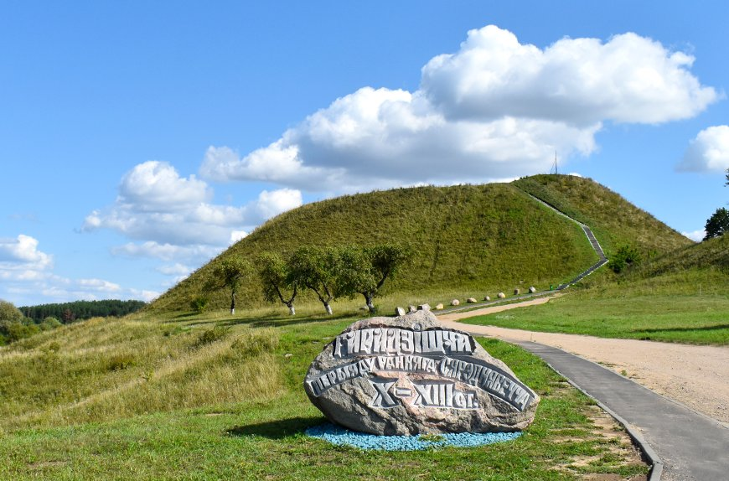
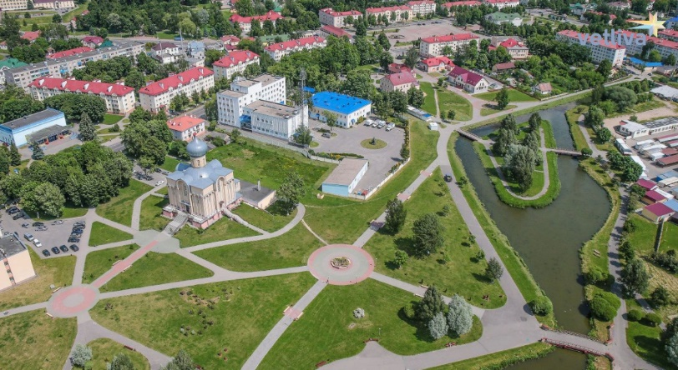
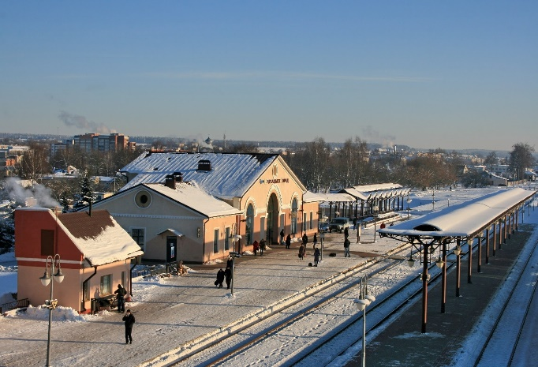
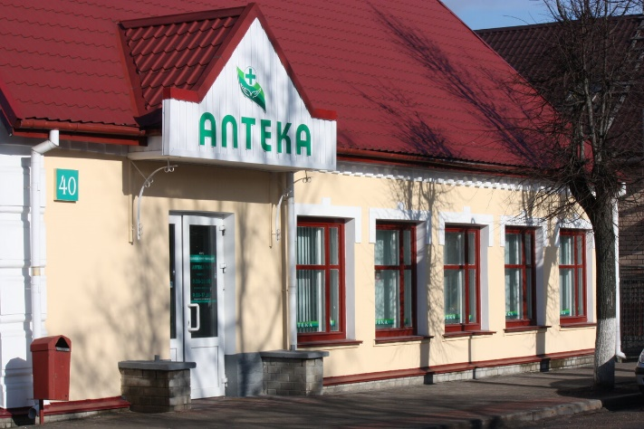
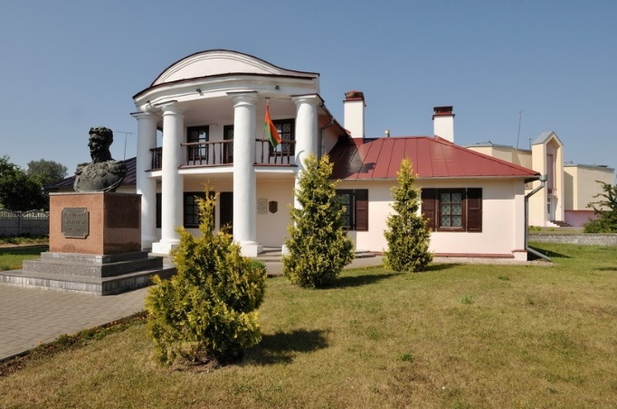
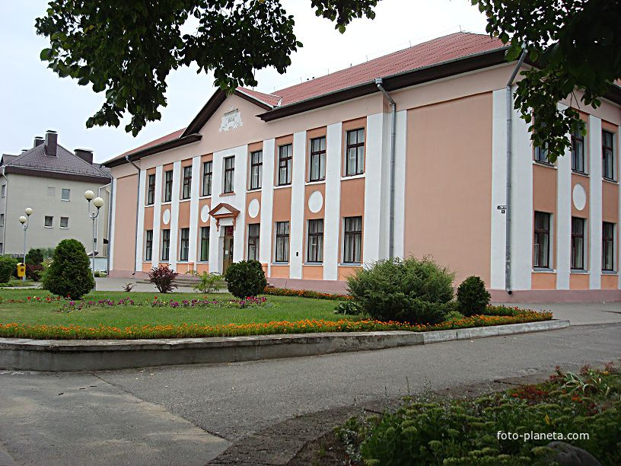
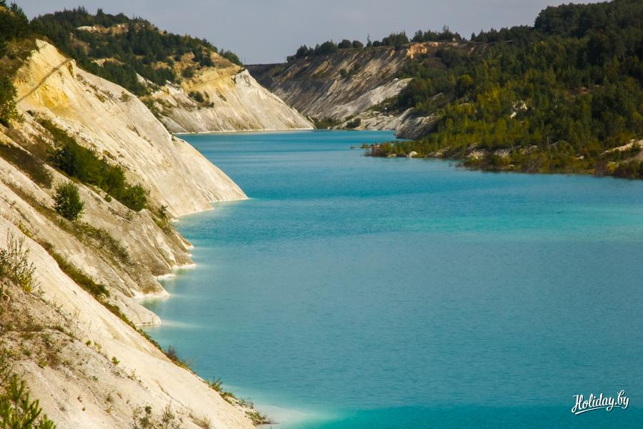
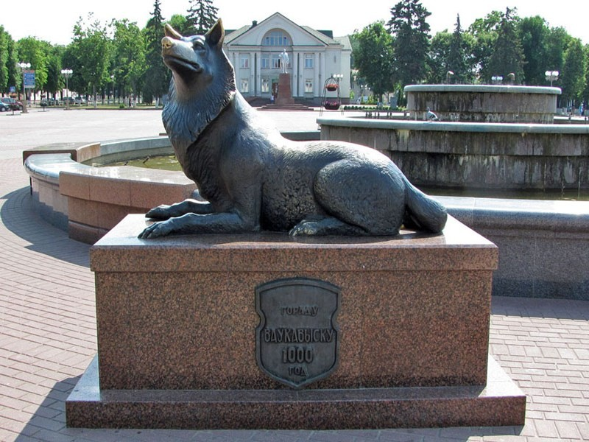

Slide 2
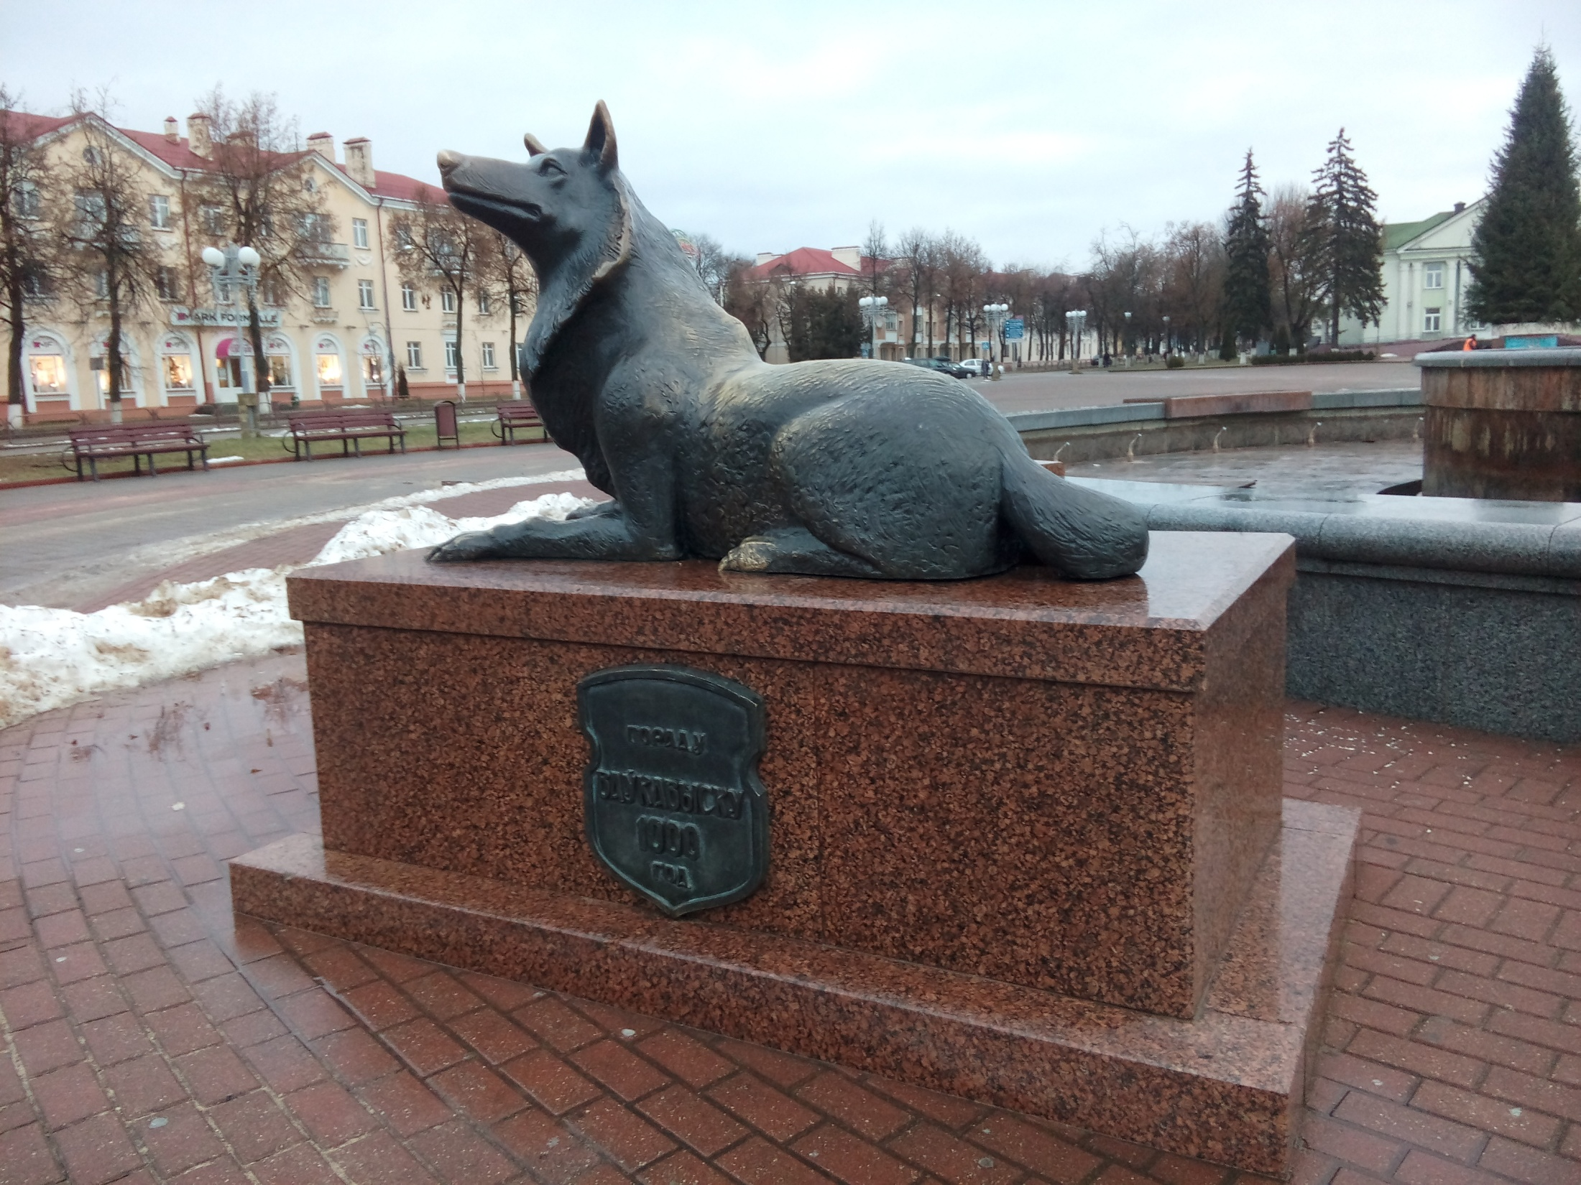
My Town
Our tasks:
To practice our speech
To read the text about our town
To listen to the audio
To name 5 reasons to visit Volkovysk

Slide 3
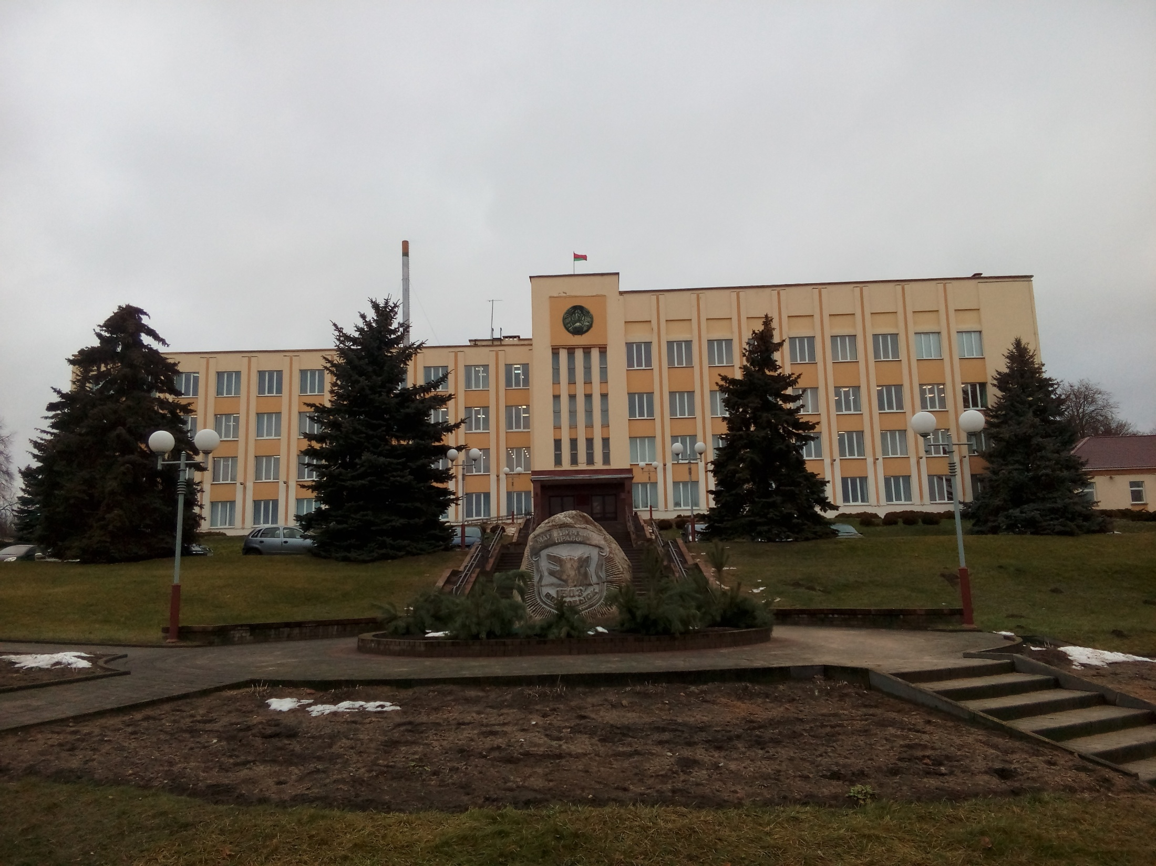
Phonetic Drill
The more we read, the more we know,
The more we know, the more we forget,
The more we forget, the less we know,
The less we know, the less we forget,
The less we forget, the more we know,
Why study?

Slide 4
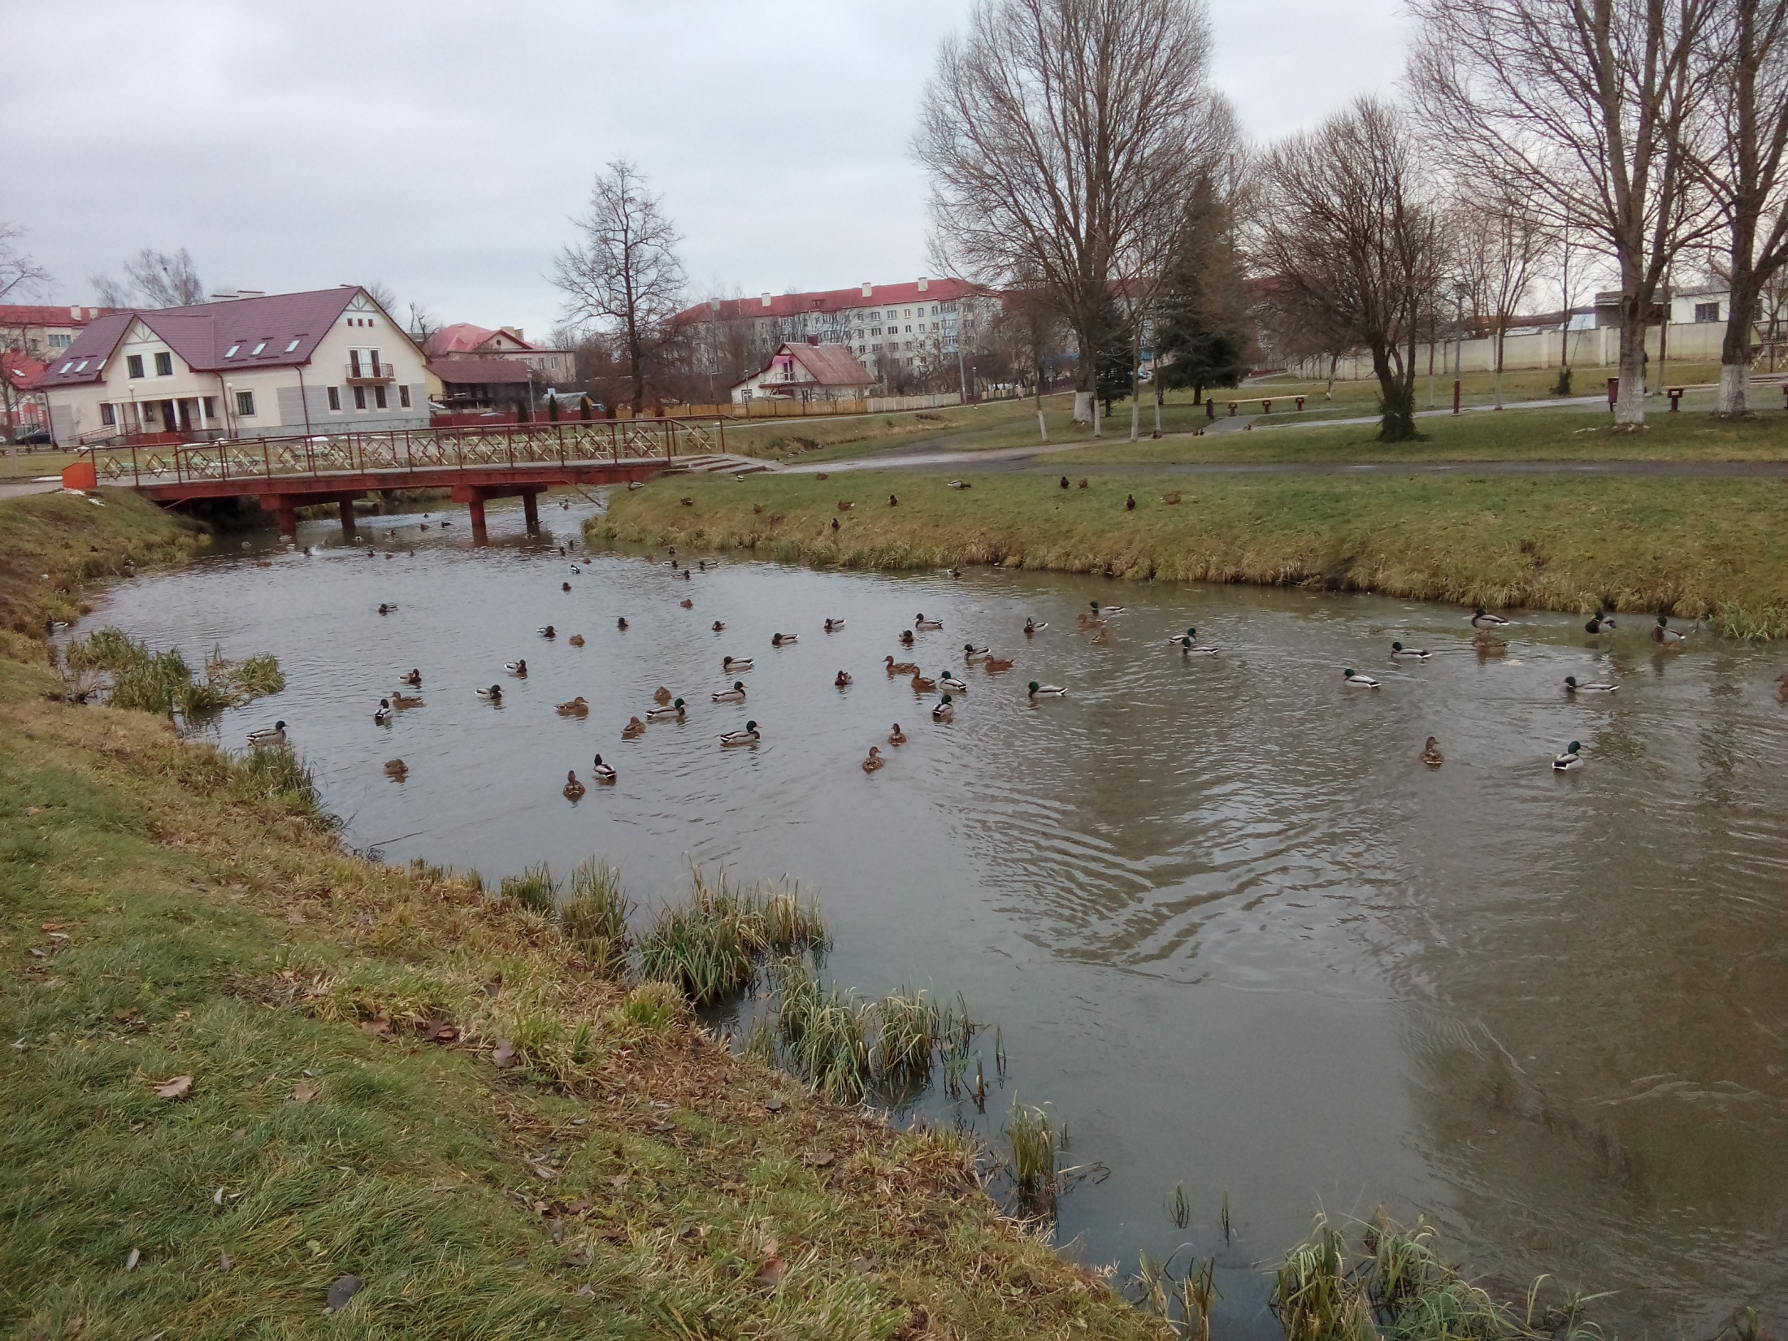
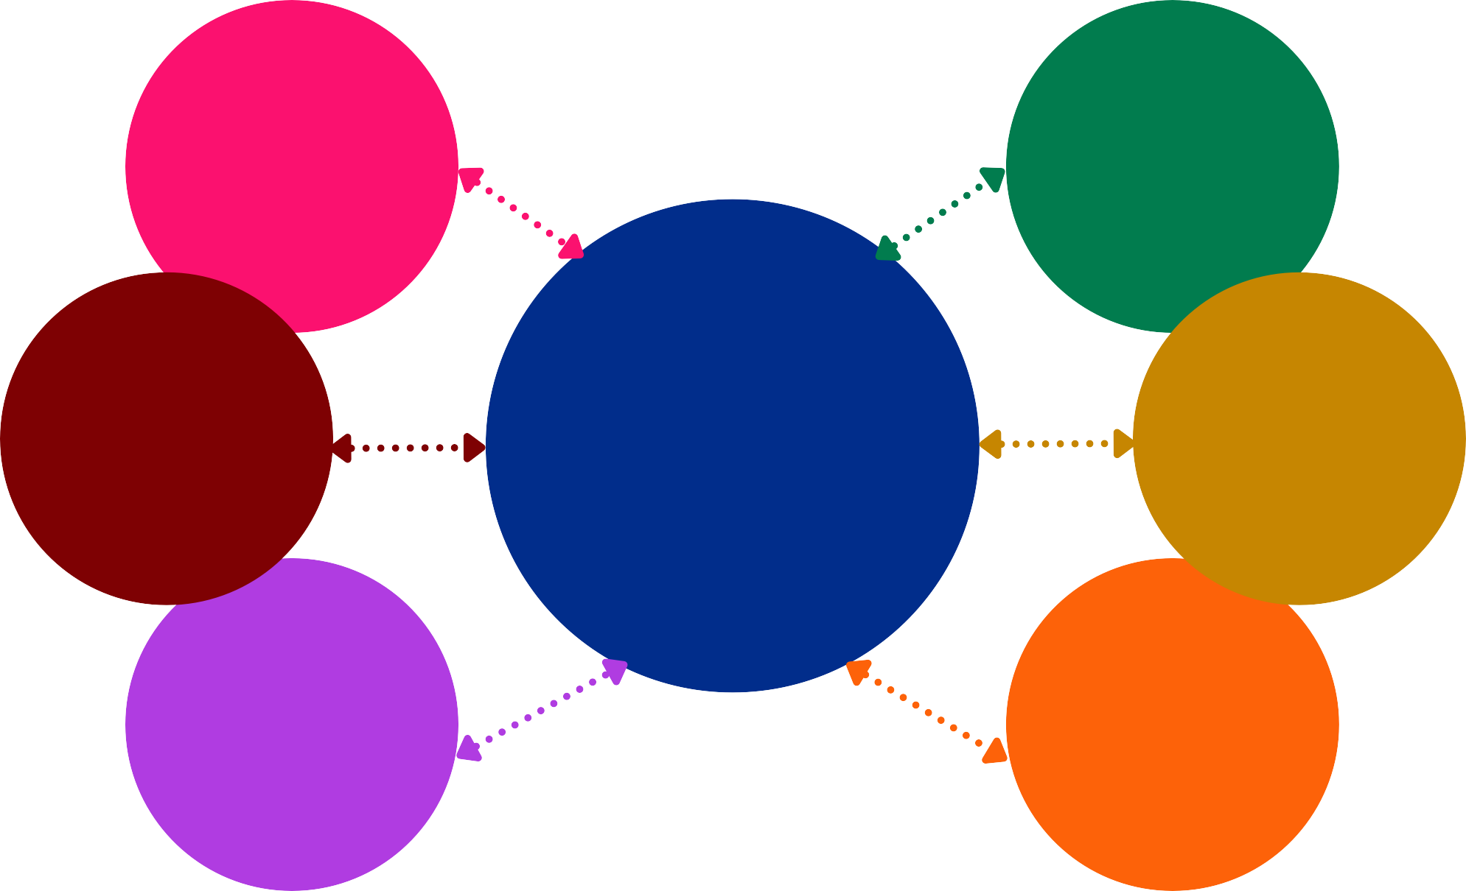
Reading
history 1005
Swedish hill
hospital
churches
library
plants
buildings school college+ music school
people hospitable
hardworking friendly
Volkovysk
town hall
cinema
museum
supermarkets
nature picturesque wonderful

Slide 5
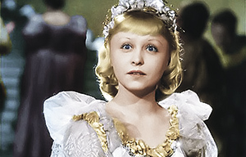
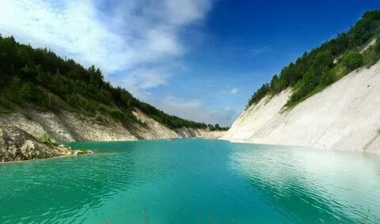
Listening FIVE REASONS TO VISIT VOLKOVYSK New words beast (a wild animal)
1.
2.
3. bulk shafts- насыпные валы quarries-карьеры
4.
5.

Slide 6
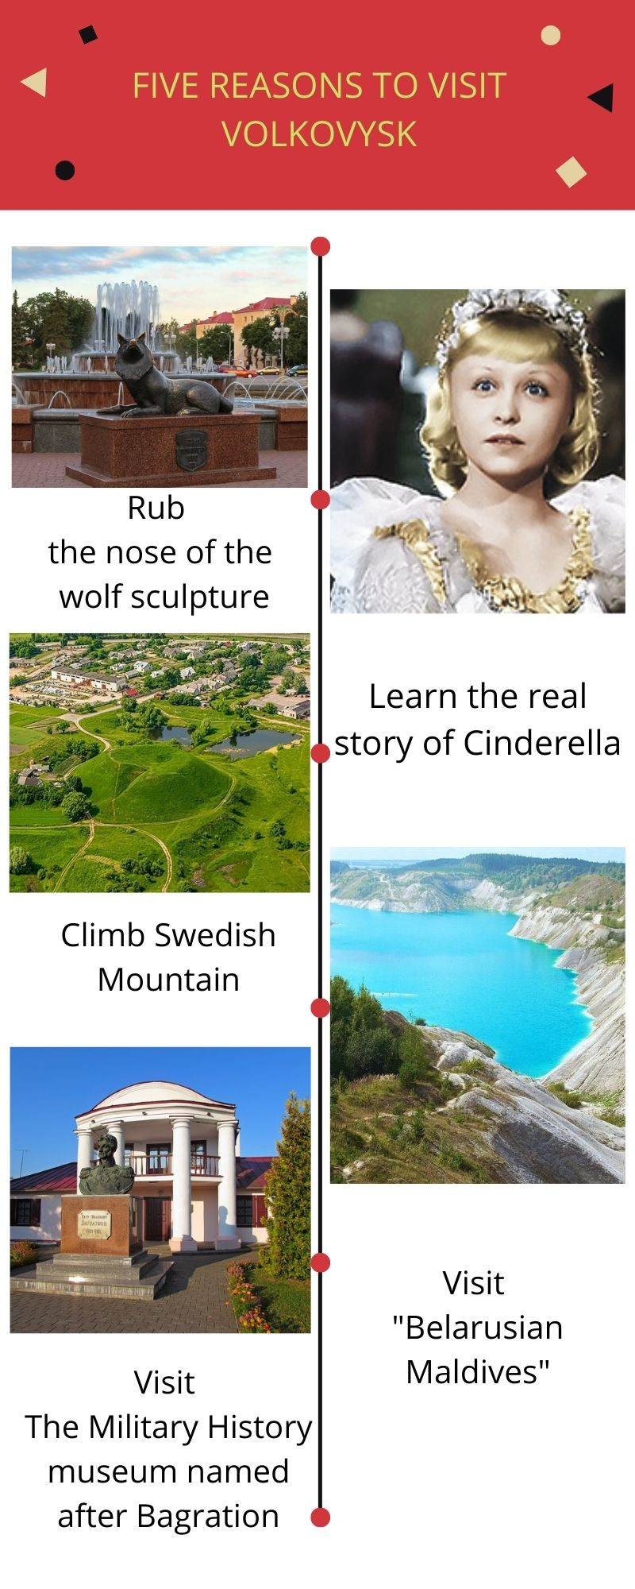

Slide 7
Refletion

Slide 8
Hometask
to advice a British visitor
to visit Volkovysk, give your reasons

